Slide 1
UNIT - 5
8051 Microcontroller Hardware :

Slide 2
Topics to be covered
Parallel Ports in 8051
External Memory interfacing with 8051
8051 Timers
8051 Serial ports
8051 Interrupts
Introduction to ARM7TD

Slide 3
8051 Foot Print
5.1. Parallel Ports in 8051
P1.0
1
40
Vcc
P1.1
2
39
P0.0(AD0)
P1.2
3
38
P0.1(AD1)
P1.3
4
8051
(8031)
(8751)
(8951)
37
P0.2(AD2)
P1.4
5
36
P0.3(AD3)
P1.5
6
35
P0.4(AD4)
P1.6
7
34
P0.5(AD5)
P1.7
8
33
P0.6(AD6)
RST
9
32
P0.7(AD7)
(RXD)P3.0
10
31
EA/VPP
(TXD)P3.1
11
30
ALE/PROG
(INT0)P3.2
12
29
PSEN
(INT1)P3.3
13
28
P2.7(A15)
(T0)P3.4
14
27
P2.6(A14)
(T1)P3.5
15
26
P2.5(A13)
(WR)P3.6
16
25
P2.4(A12)
(RD)P3.7
17
24
P2.3(A11)
XTAL2
18
23
P2.2(A10)
XTAL1
19
22
P2.1(A9)
GND
20
21
P2.0(A8)

Slide 4
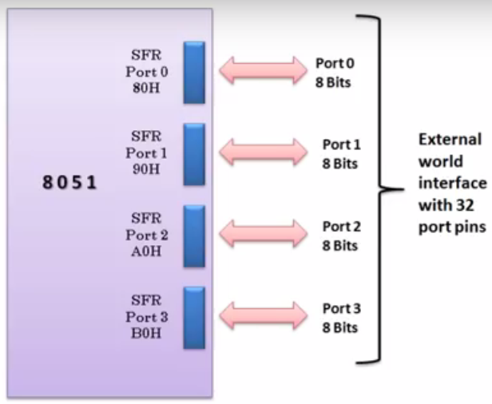
5.1. Parallel Ports in 8051

Slide 5
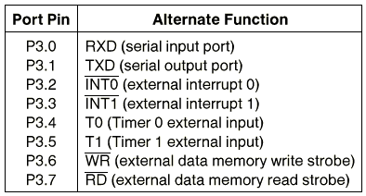
Port 3 Alternate Functions
5.1. Parallel Ports in 8051 cont’d…

Slide 6
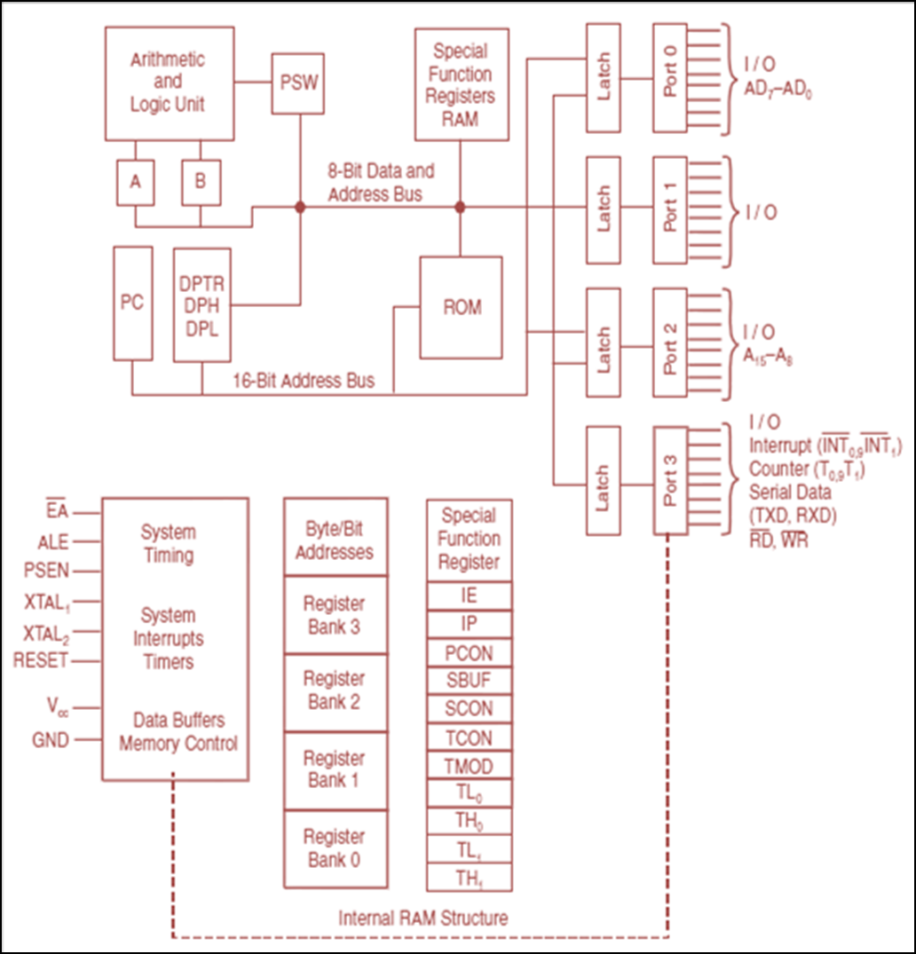
8051- Architecture

Slide 7
Hardware Structure of Port 1 I/O Pin
5.1. Parallel Ports in 8051 cont’d…
Read latch
Vcc
TB2
Load(L1)
Internal CPU bus
D Q
Clk Q
P1.X pin
P1.X
Write to latch
M1
TB1 :
Tri-state Buffer
Read pin

Slide 8
Hardware Structure of I/O Pin
5.1. Parallel Ports in 8051 cont’d…
Each pin of I/O ports
Internally connected to CPU bus
A D latch store the value of this pin
Write to latch＝1：write data into the D latch
2 Tri-state Buffer：
TB1: controlled by “Read pin”
Read pin＝1： read the data present at the pin
TB2: controlled by “Read latch”
Read latch＝1：read value from internal latch
A transistor M1 gate
Gate=0: open
Gate=1: close

Slide 9
Writing “1” to Output Pin P1.X
5.1. Parallel Ports in 8051 cont’d…
Read latch
Vcc
TB2
Load(L1)
2. output pin is Vcc
1. write a 1 to the pin
1
P1.X pin
Internal CPU bus
D Q
Clk Q
P1.X
0
output 1
Write to latch
M1
TB1
Read pin

Slide 10
Writing “0” to Output Pin P1.X
5.1. Parallel Ports in 8051 cont’d…
Read latch
Vcc
TB2
Load(L1)
2. output pin is ground
1. write a 0 to the pin
0
P1.X pin
Internal CPU bus
D Q
Clk Q
P1.X
1
output 0
Write to latch
M1
TB1
Read pin

Slide 11
Reading “High” at Input Pin
5.1. Parallel Ports in 8051 cont’d…
Read latch
Vcc
2. MOV A,P1
external pin=High
TB2
write a 1 to the pin MOV P1,#0FFH
Load(L1)
1
1
P1.X pin
Internal CPU bus
D Q
Clk Q
P1.X
0
M1
Write to latch
TB1
Read pin
3. Read pin=1 Read latch=1 Write to latch=1

Slide 12
Reading “Low” at Input Pin
5.1. Parallel Ports in 8051 cont’d…
Read latch
Vcc
2. MOV A,P1
external pin=Low
TB2
write a 1 to the pin
MOV P1,#0FFH
Load(L1)
1
0
P1.X pin
Internal CPU bus
D Q
Clk Q
P1.X
0
M1
Write to latch
TB1
Read pin
3. Read pin=1 Read latch=0 Write to latch=1
8051 IC

Slide 13
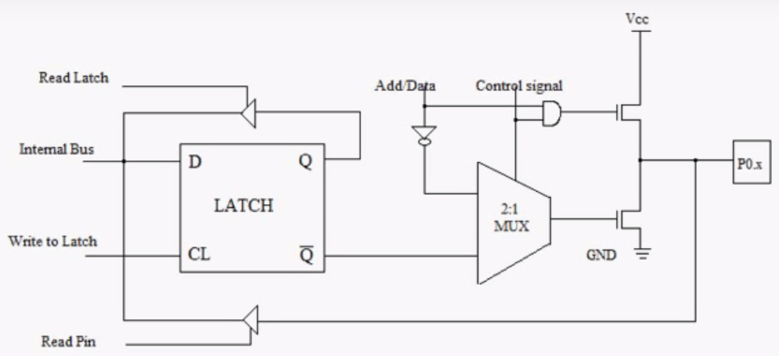
Port 0 Configuration
5.1. Parallel Ports in 8051 cont’d…
ALE

Slide 14
Port 0 with external Pull-Up Resistors
5.1. Parallel Ports in 8051 cont’d…
Vcc
10 K
Port 0
P0.0
DS5000
8751
8951
P0.1
P0.2
P0.3
P0.4
P0.5
P0.6
P0.7

Slide 15
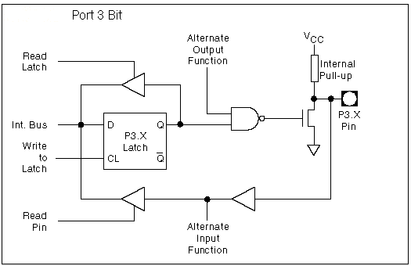
8051 Port 3 Bit Latches and I/O Buffers
5.1. Parallel Ports in 8051 cont’d…

Slide 16
Address Multiplexing for External Memory
5.2 External Memory interfacing with 8051
Figure 5.2.1
Multiplexing the address (low-byte) and data bus

Slide 17
Address Multiplexing for External Memory
Figure 2-8
Accessing external code memory

Slide 19
Accessing External Data Memory
Figure 2-11
Interface to 1K RAM

Slide 20
Timing for MOVX instruction

Slide 21
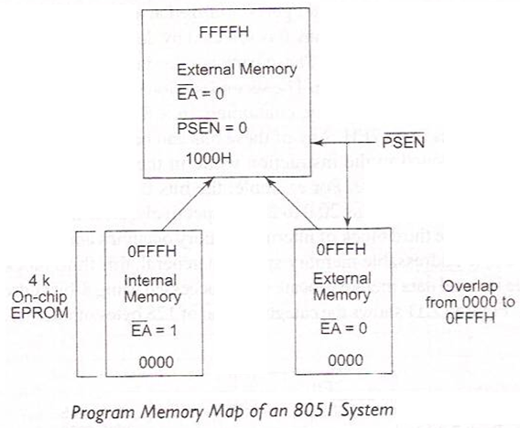
8051- Architecture cont’d…
ROM Organization: -
DPTR is used to access external data memory (External RAM)
is used to access external program memory (External ROM)

Slide 22
External code memory
WR
RD
PSEN
OE
ALE
74LS373
CS
G
P0.0
P0.7
A0
A7
D
D0
D7
EA
P2.0
P2.7
A8
A15
8051
ROM

Slide 23
External data memory
WR
WR
RD
RD
PSEN
ALE
74LS373
CS
G
P0.0
P0.7
A0
A7
D
D0
D7
EA
P2.0
P2.7
A8
A15
8051
RAM

Slide 24
Overlapping External Code and Data Spaces

Slide 25
Overlapping External Code and Data Spaces
WR
WR
RD
PSEN
RD
ALE
74LS373
CS
G
P0.0
P0.7
A0
A7
D
D0
D7
EA
P2.0
P2.7
A8
A15
8051
RAM

Slide 26
Overlapping External Code and Data Spaces
Allows the RAM to be
written as data memory, and
read as data memory as well as code memory.
This allows a program to be
downloaded from outside into the RAM as data, and
executed from RAM as code.

Slide 27
5.2 External Memory interfacing with 8051 cont’d…
Chip capacity: number of bits that a semiconductor memory chip can store.
It can be in units of Kbits (kilobits), Mbits (megabits), and so on....
A memory chip contain 2^{X} location, where x is the number of address pins.
Each location contains Y bits, where y is the number of data pins on the chip.
The entire chip will contain 2^{X} × Y bits.

Slide 28
5.2 External Memory interfacing with 8051 cont’d…
Example : 1
A given memory chip has 12 address pins and 4 data pins.
Find: (a) The organization, and (b) the capacity.
Solution:
This memory chip has 4096 locations (2¹² = 4096),
and each location can hold 4 bits of data.
This gives an organization of 4096 × 4, often represented as 4K × 4.
(b) The capacity is equal to 16K bits since there is a total of 4K locations
and each location can hold 4 bits of data.

Slide 29
5.2 External Memory interfacing with 8051 cont’d…
Example 2 :
A 512K memory chip has 8 pins for data. Find:
The organization, and
The number of address pins for this memory chip.
Solution:
(a) A memory chip with 8 data pins means that each location within the chip can hold 8 bits of data.
To find the number of locations within this memory chip, divide the capacity by the number of data pins. 512K/8 = 64K;
therefore, the organization for this memory chip is 64K × 8
(b) The chip has 16 address lines since 2¹⁶ = 64K

Slide 30
8051 Connection to External Data ROM

Slide 31
5.2 External Memory interfacing with 8051 cont’d…

